Slide 1


Implementation of Ensemble Kalman Filters in Stone-Soup
John Hiles¹, Sean O’Rourke², Ruixin Niu¹, and Erik Blasch³
Virginia Commonwealth University¹
Air Force Research Laboratory²
Air Force Office of Scientific Research³

Slide 2

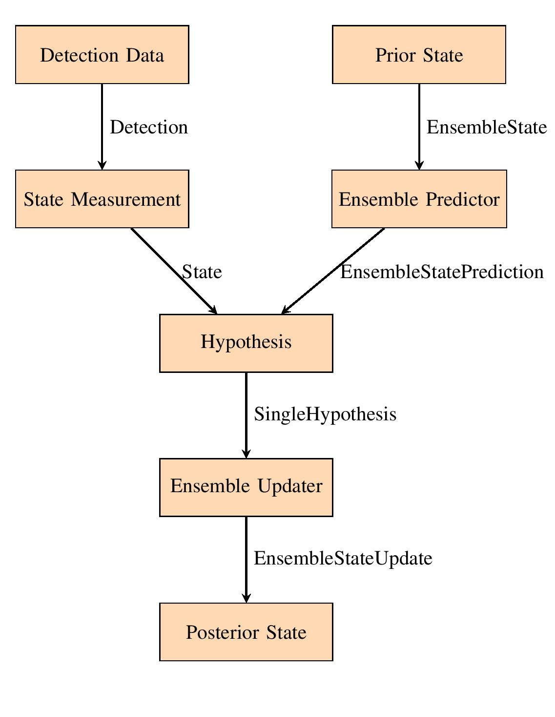
Motivation
Our Aim: to implement Ensemble Kalman Filter and Ensemble Square Root Filter in Stone Soup.
This implementation in Stone Soup offers value to the tracking community by requiring little knowledge of the EnKF to deploy.
Implementation emphasizes compatibility and ease of use
Only requires user to specify ensemble size
Native framework components allow for intuitive manipulation of the State Ensemble
Works with nonlinear transition and measurement models
Data flow of one iteration of the filter
2

Slide 3


The Stone Soup Framework

Slide 4
Tracking Frameworks
AN ELEPHANT’S GRAVEYARD OF SOLUTIONS
Long history of “unified” frameworks for tracking, with varying levels of uptake
Historical Examples:
ReBEL: Recursive Bayesian Estimation Library (Wan & van der Merwe, late 2000s): MATLAB,
NEF: Nonlinear Estimation Framework (Erik Blasch, et al., 2010s): MATLAB, object-oriented, very general
Untitled, Unreleased UC Irvine Framework (O’Rourke, et al., 2011-4): MATLAB, function-oriented, intended for control
Current Examples:
Tracker Component Library (TCL): MATLAB/C, function-oriented
Maintained by Naval Research Laboratory
Open version on Github: https://github.com/USNavalResearchLaboratory/TrackerComponentLibrary
Stone Soup: Python, object-oriented
A project of the Open Source Tracking & Estimation Working Group of ISIF
Open version on Github: https://github.com/dstl/Stone-Soup
3

Slide 5
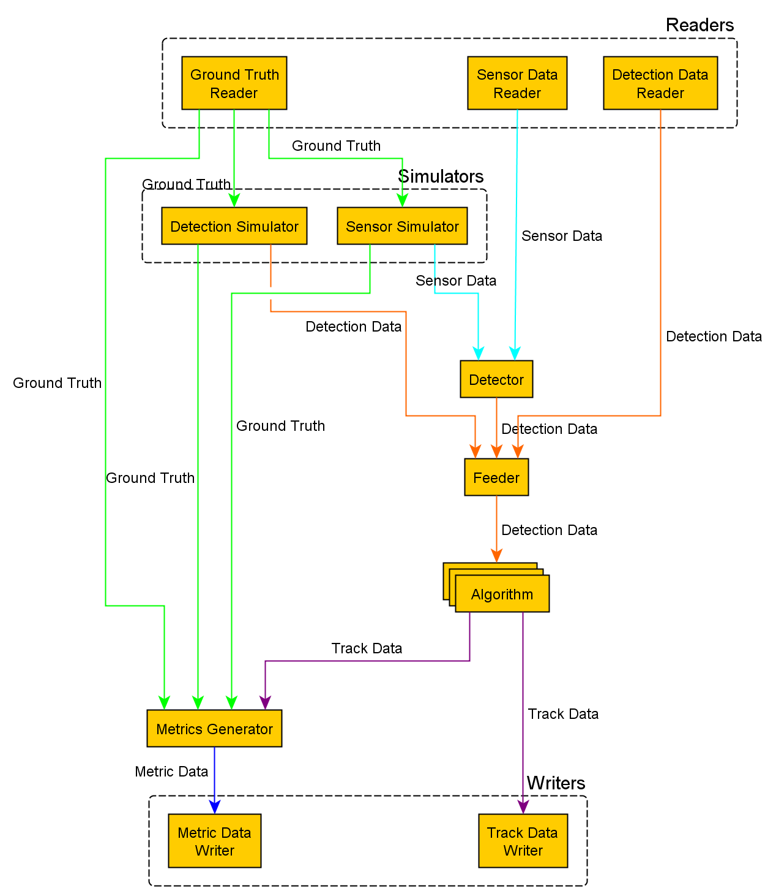

Tracking Frameworks – Stone Soup
OPEN SOURCE!
Highly modular – see figure
Has the advantages of any Python based system
Easy to prototype ideas if your workflow is set up for it
Major needs:
More algorithms
Currently the framework supports the Kalman Filter, Extended-KF, the Particle Filter, among others.
Datasets that can fit the framework
Datasets often require somewhat restrictive formatting
Documentation
There is a need for more tutorial content
Graphic from [2] Stone Soup documentation
4

Slide 6
Why the Ensemble Kalman Filter?

Slide 7
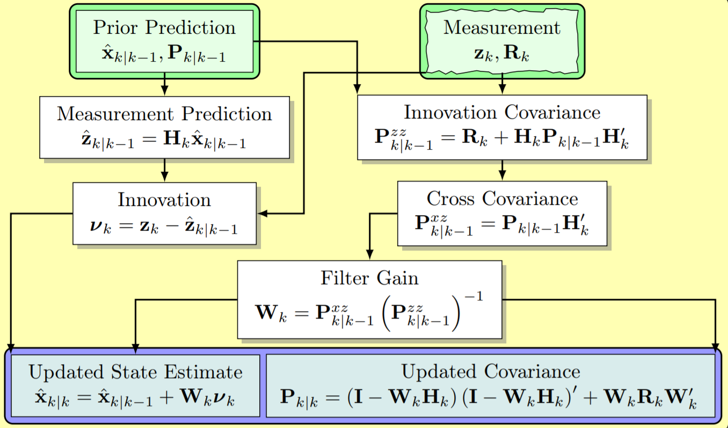
The (Vanilla) Kalman Filter
The Kalman Filter was introduced in 1960 by Rudolf E. Kalman.
It is a recursive filter that predicts the system’s state, then updates that prediction based on measurement data.
The Kalman Filter is elegant, but it relies on restrictive assumptions:
The observed system must transition from time step to time step via a linear model.
The sensor’s output must map to the state space via a linear model.
All deviations from the underlying deterministic models follow Gaussian distributions.
Graphic from [3] “A Crash Course in Basic Single-Scan Target Tracking”
5

Slide 8
But what if I want to track something Nonlinear?

Slide 9
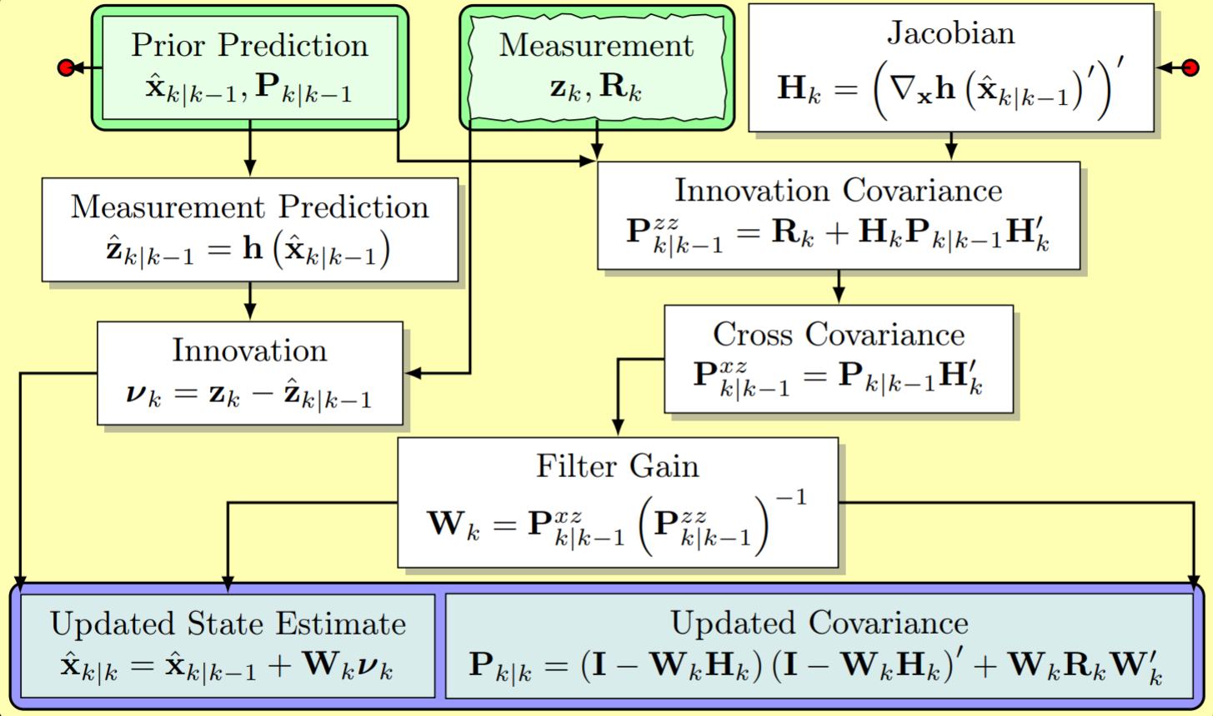
The Extended Kalman Filter
The Extended Kalman Filter is (probably) the most widespread solution to the KF’s linearity constraint
The EKF involves using the Jacobian to linearize the transition and measurement model
A very simple solution
Computationally inexpensive
Jacobian is only valid locally
Filter stability depends on measurement accuracy
Finicky
Often requires careful tuning by users
Both the EKF and KF become computationally expensive for high dimensional problems.
Graphic from [3] “A Crash Course in Basic Single-Scan Target Tracking”
6

Slide 10
But what if the dimension of my state is really big?

Slide 11
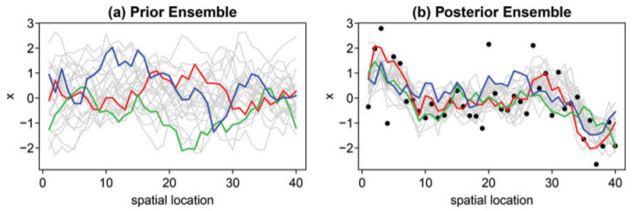
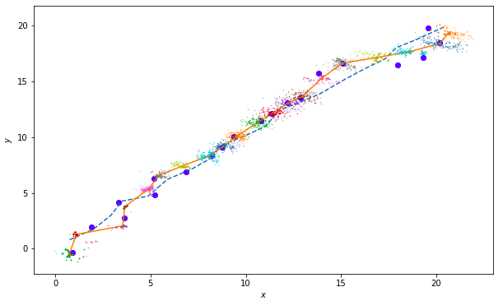
The Ensemble Kalman Filter
The Ensemble Kalman Filter was introduced in 1994 by Dr. Gier Evensen, a Geophysicist.
It was originally developed for use in geophysical problems
Large number of dimensions
Highly nonlinear
The EnKF is a numerical approximation of the linear Kalman Filter
The EnKF uses the Kalman Update scheme to update a collection of state vectors.
Each ensemble member, is then assumed to be a sample, of the underlying “true” probability distribution of the state
For linear Gaussian problems as the number of vectors approaches infinity, the EnKF converges to the standard Kalman Filter.
Ensemble Kalman Filter
Top Figure from [1] “Understanding the Ensemble Kalman Filter”;
Bottom figure generated by ourselves.
7

Slide 12
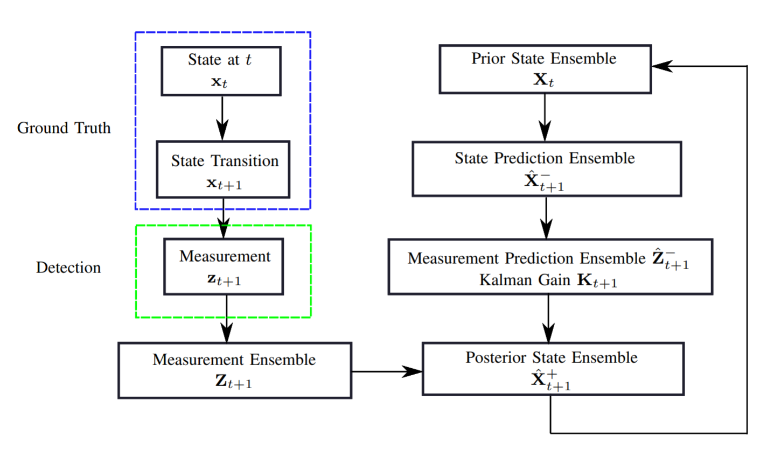
The Ensemble Kalman Filter
The EnKF requires relatively small Ensemble Size “M” to produce reasonable results
For low “n” dimension problems, the EnKF is significantly more computationally expensive than non Monte Carlo methods
Note the EnKF is requires far smaller ensemble sizes compared to the Particle Filter
The EnKF’s computational cost versus its performance is highly efficient when M << n
8

Slide 13
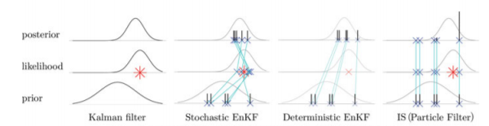
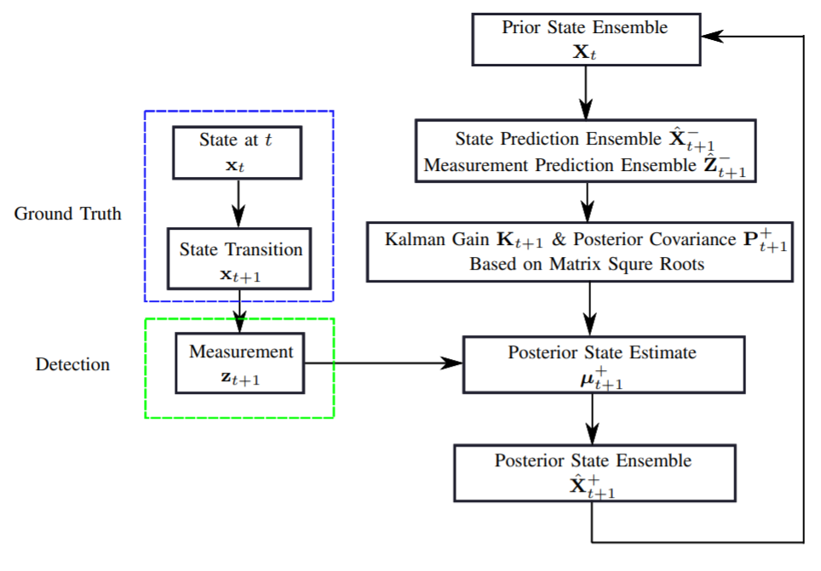
The Ensemble Square Root Filter
A controversial aspect of the EnKF is the measurement perturbation
When a measurement is taken, an ensemble is generated, introducing sampling error.
This is considered a “stochastic” update, in contrast to a “deterministic” update.
The Ensemble Square Root Filter propagates the mean and covariance, then samples a new Ensemble
The standard EnKF by contrast, updates each vector in the ensemble individually
Due to fact it updates with the measurement in vector form, it performs better than the EnKF for small ensembles.
Top Figure from [1] “Understanding the Ensemble Kalman Filter”;
Bottom figure generated by ourselves.
9

Slide 14
In Summary:
What do Ensemble based filters bring to the table?
More robust than EKF, requires less tuning
Computationally inexpensive for M<<n
Requires far smaller ensembles than Particle Filter
What are drawbacks?
For small states, somewhat computationally expensive
Sample covariance can introduce bias which doesn’t exist in system
Prone to sampling error (less so for deterministic filters)
10

Slide 15
Implementation (This part is geared towards Stone Soup developers)

Slide 16
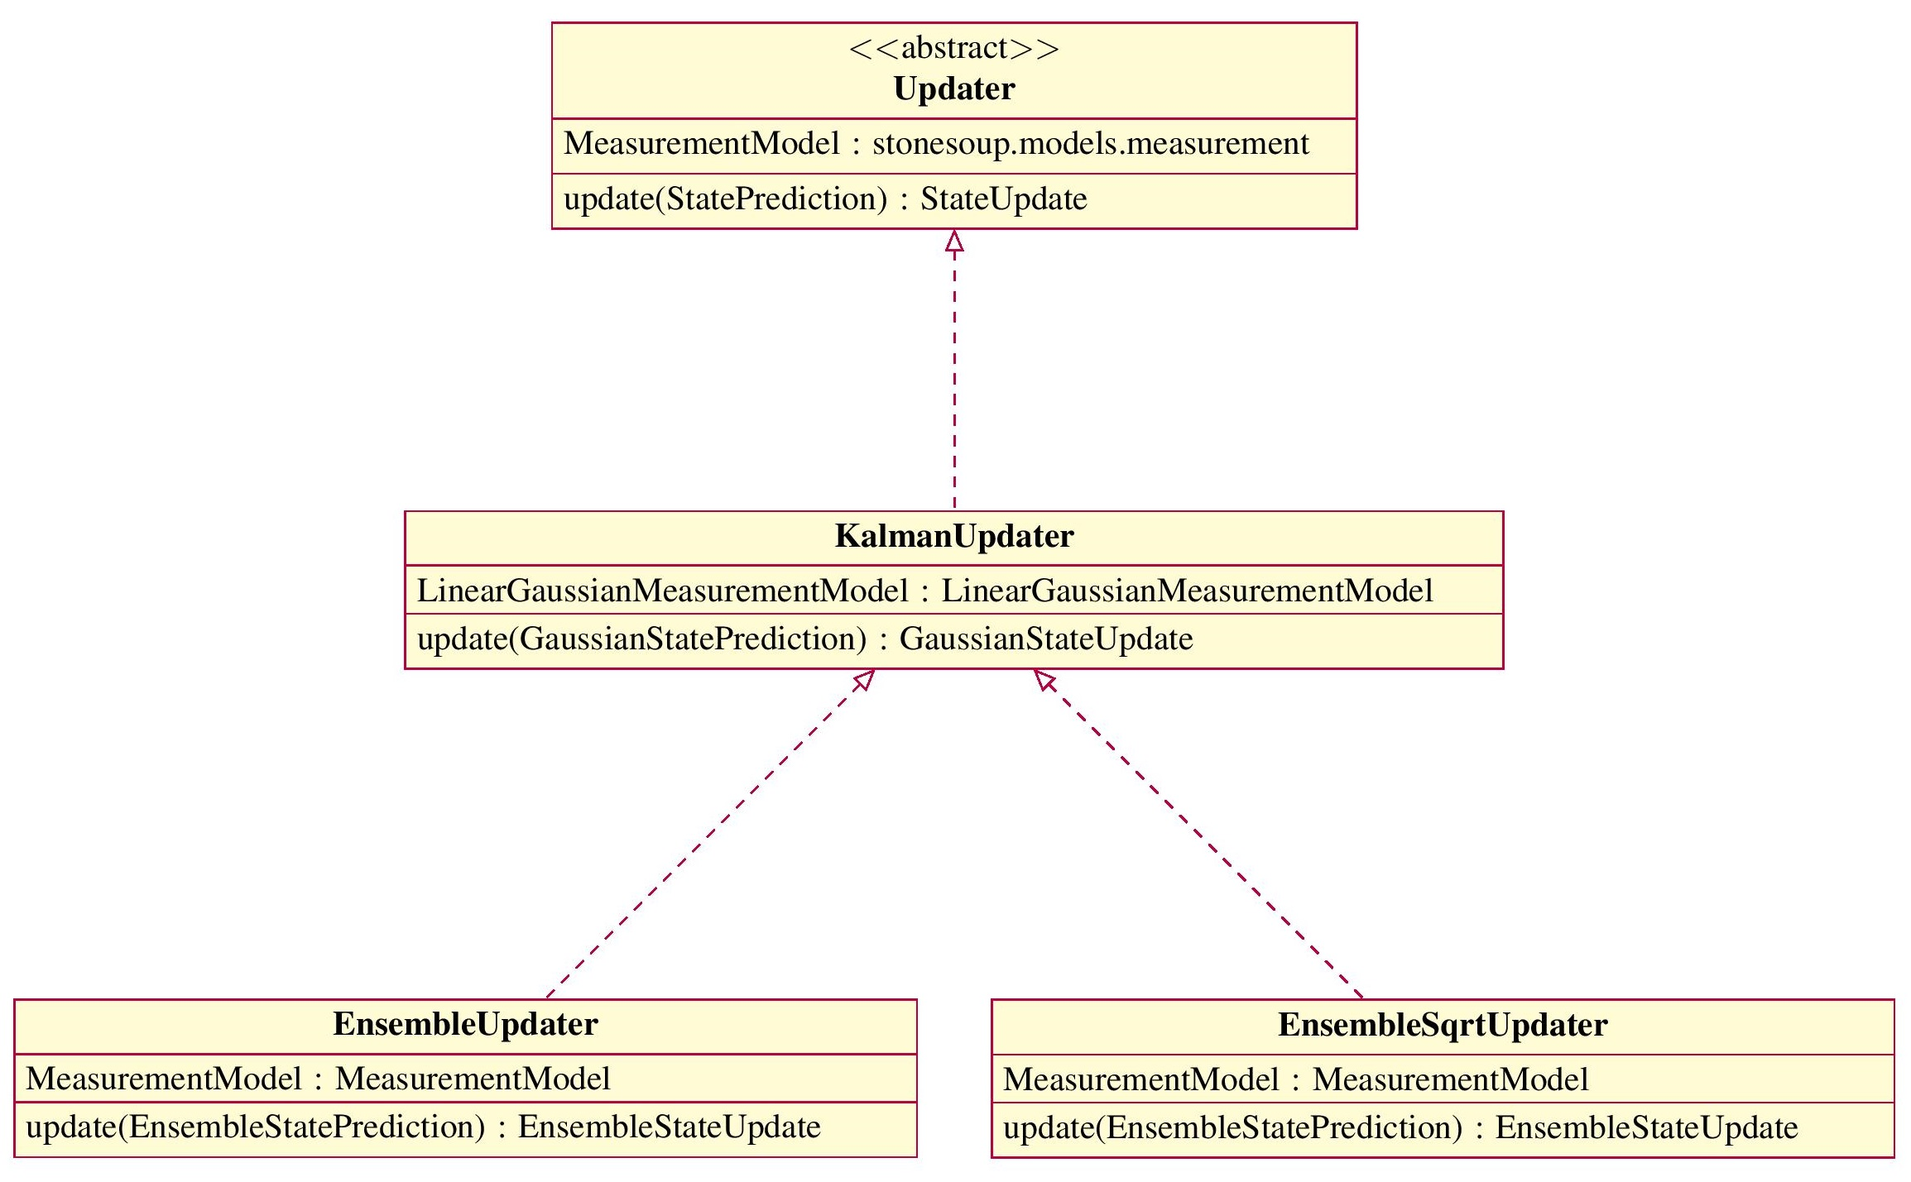
Class Design
Four components were introduced:
EnsembleState
Contains state info
EnsemblePredictor
Applies predictions to an ensemble
EnsembleUpdater
EnKF Update Routine
EnsembleSqrtUpdater
EnSRF Update Routine
Both Ensemble Updaters and the Ensemble Predictor inherit from their respective Kalman Filter components.
This is because of the structural similarities between the EnKF and KF
Updater and Predictor use internal class methods from KF
11

Slide 17
Class Design
The more innovative aspect of this implementation is the usage of the statevectors data type
Originally for time series data, the StateVectors container is used to store the ensemble of vectors at each time step
The Predictor and EnKF/EnSRF updater classes function identically to other Stone Soup updaters, however they operate on EnsembleState objects
This abstraction essentially allows developers to treat the ensemble as the state
Right figure shows data flow through one iteration of the EnKF
Data flow of one iteration of the filter
12

Slide 18
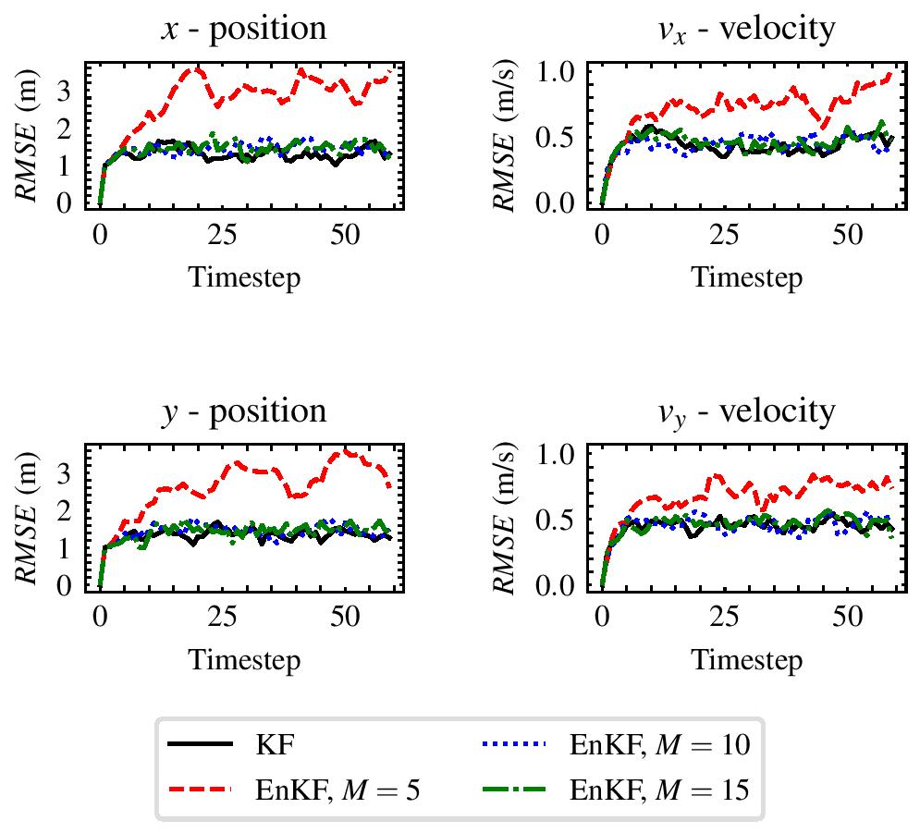
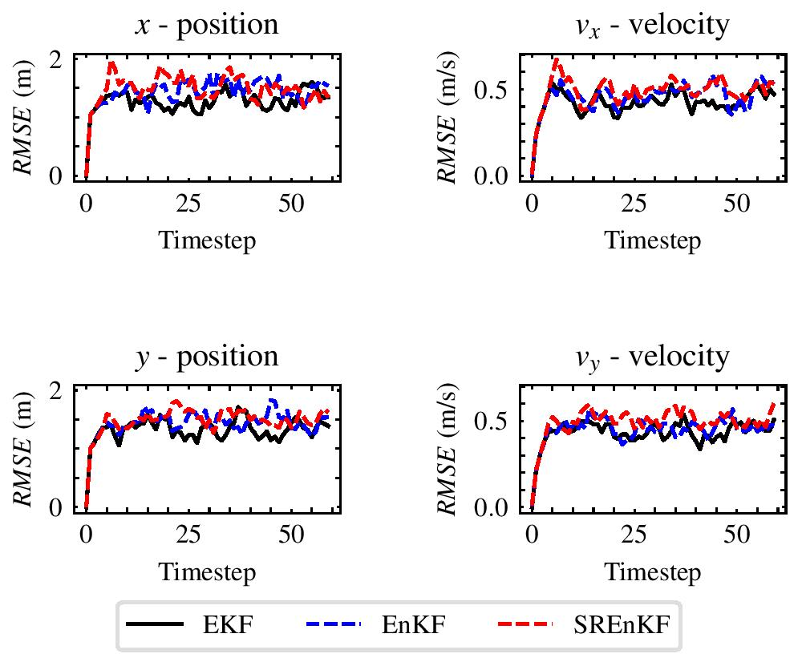
Simulation Results
Convergence for Linear Gaussian Models
Objective: Verify our filters converge to the Kalman Filter’s result for linear Gaussian problems
The simulations used to generate our figures will be made publicly available via a public Github repository
A pull request has been submitted for inclusion of our EnKF and EnSRF to the Stone Soup repository.
Future Work:
Development on Polynomial Chaos based Ensemble Kalman Filters
Representation of a PDF based on sums of Hermite Polynomials
Performance for nonlinear models, M=50
13

Slide 19
References
[1] Matthias Katzfuss, Jonathan R. Stroud & Christopher K. Wikle (2016) Understanding the Ensemble Kalman Filter, The American Statistician, 70:4, 350-357, DOI: 10.1080/00031305.2016.1141709 Promising new derivative algorithms are in active development.
[2] “Enabling Components” Framework Design - Stone Soup 0.1b1 Documentation, stonesoup.readthedocs.io/en/latest/design.html.#Components
[3] David Crouse, “A Crash Course in Basic Single-Scan Target Tracking” US Naval Research Laboratory
14

